Slide 1
Algorithms for Updating and Visualizing Dynamic Networks
Presented by
Sriram Srinivasan
sriramsrinivas@unomaha.edu
github.com/SriramSrinivas/SriramDissertation
Date :- 03/06/2020

Slide 2
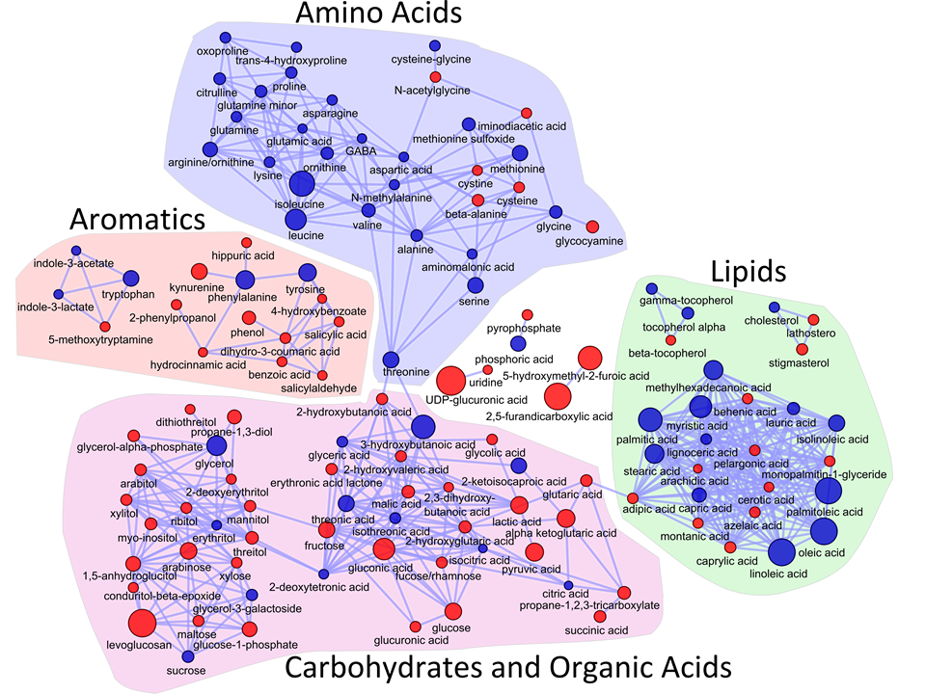
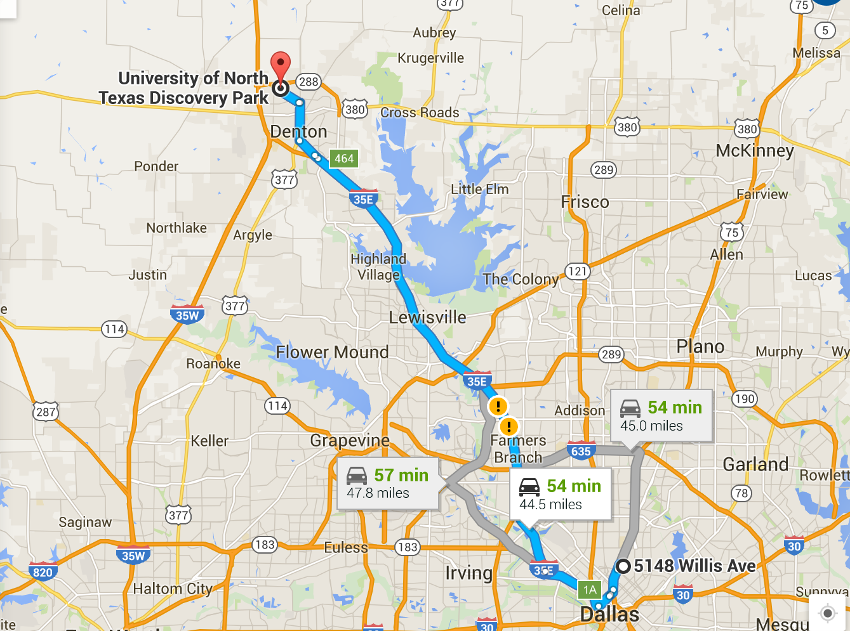

Networks
Networks (graphs) are used to model interaction among entities

Slide 3
Dynamic Networks
Analyzing properties of the networks can help in understanding the characteristics of the underlying systems
Communities indicate groups of friends in social networks
High centrality vertices indicate in important proteins in PPI networks
Networks can evolve with time, so the properties of the dynamic networks have to be updated
Goal: Update only the part of the network affected by the change, rather than recomputing from scratch

Slide 4
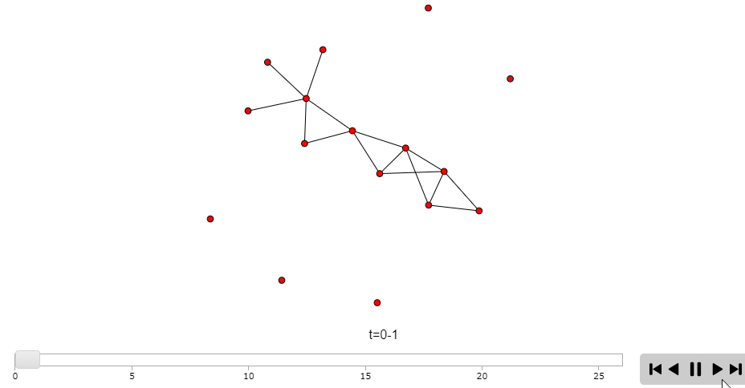
Dynamic Networks Visualization
** Simulation was designed using R & d3.js (work still in progress to visualize real-world dynamic networks) **

Slide 5
Graph Properties
A
1
4
2
B
C
2
Minimum Weighted Spanning Tree (MST)
Select a subset of edges from an undirected weighted graph (V,E), such that
(i) all the vertices are connected
(ii) the sum of the total edges is minimized
Single Source Shortest Path (SSSP)
Find the shortest distance of all vertices from a given source vertex
2
2
F
A
1
2
D
E
1
2
B
C
2
F
1
2
D
E
MST: Key Edges
A
1
2
B
C
2
2
F
1
D
E
SSSP: Key Edges

Slide 6
The naïve approach
Recompute from scratch
Generate new graph after updates, perform SSSP, MST again
Can we do better than recomputing from scratch?

Slide 7
Related Work
Libraries for dynamic data/graph analysis
e.g., Sandia PHISH, Georgia Tech Stinger
Dynamic graph algorithms
e.g., Ramalingam-Reps, Narvez et al.
Parallel algorithms, implementations for SSSP in static graphs
e.g., Delta-stepping, DSMR

Slide 8
Template for Parallel Algorithm
Sparsification
Compute only over the edges that affect the property (Key Edges)
Remaining edges accessed for deletion only
Preprocessing before input of changes
Selection
Identify the added/deleted edges that affect the property
Can be done in parallel for each edge
Edges are not yet added or deleted from the MST
Updating
Update set of key edges according to the changes
Parallel over the edges, but requires multiple iterations
Non-key edges may need to be processed

Slide 9
Updating Single Source Shortest Path
Original Network
Sparsification
A
A
1
4
1
Change Set
A:F:1 (Ins)
A:D:4 (Ins)
D:B:2 (Del)
A:C:4 (Del)
2
2
B
C
2
B
C
2
2
2
F
2
F
1
2
1
D
E
D
E
Selection
Updating
A
A
1
1
1
4
1
4
2
2
2
B
C
B
C
2
2
F
F
2
1
2
D
1
E
D
E

Slide 10
Shared-memory parallelization
The Selection step is easy to implement and shows good load balance
The parallel performance of the Updating step is dependent on the number of affected vertices and the size of the subgraphs they alter. Vertex degree distributions can cause further load imbalance.
Asynchronous updates: can process longer paths instead of just neighbors. Reduce number of synchronization steps.

Slide 11
Empirical results
Results on a 36-core Intel Haswell system with 256 GB memory
OpenMP implementation
Comparison to SSSP implementation in Galois v2.2.1
Synthetic RMAT-G (skewed degree distribution) and RMAT-ER (normal degree distribution) graphs, three real-world graphs from SNAP

Slide 12
Comparison to recomputation-based approach for SSSP
New algorithm is up to 4X faster.

Slide 13
Strong scaling (synthetic graphs) for SSSP

Slide 14
Strong scaling (real-world graphs) for SSSP

Slide 15
Applications of dynamic SSSP?
Many applications
Maps and GPS
Internet routing
Path planning for robots
Discrete event simulations
Centrality analysis in complex networks

Slide 16
Conclusions
New shared-memory algorithm for updating SSSP & MST in dynamic networks
Performance results demonstrate up to a 4X performance improvement over a parallel recomputation-based SSSP code
Plan to extend the general approach to update SCC, and PageRank
Future GPU and distributed-memory implementations
http://loki.ist.unomaha.edu/~sriramsrinivas/cist1300-sriramsrinivas/InClassExample/networkVisualization.html

Slide 17



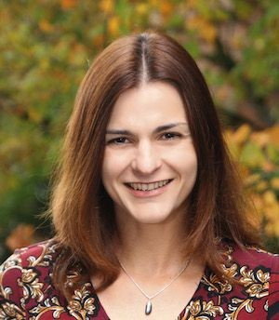

Acknowledgments & Collaborators
UNO, GRACA 2019
Dr. Sajal Das,
Missouri S&T
Dr. Boyana Norris,
University of Oregon
Dr. Kate Cooper,
UNO

Slide 18

Thank you!
Questions?
Corresponding author: Sriram Srinivasan, sriramsrinivas@unomaha.edu
github.com/SriramSrinivas/SriramDissertation

